Slide 1

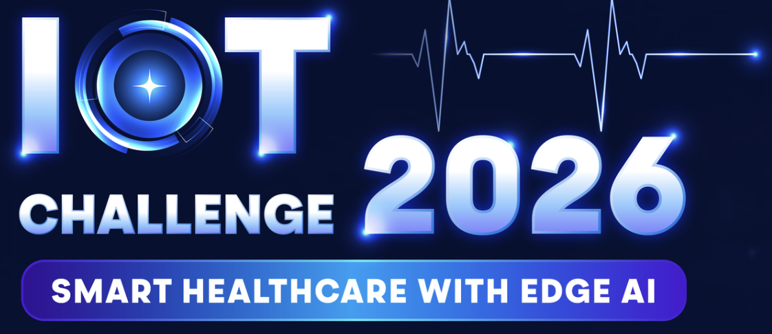
Tarang
Heart Intelligence In Motion
By Team Ocelleon
Smart Healthcare
‹#›

Slide 2

Table content
Contents
1. Introduction .................... 3
2. Objective (Problem Statement, Solution, User Flow) .................... 4
3. System Diagram (Components, Wireless Technology, Edge AI) .................... 5
4. Resource Allocation (Human Resources, Equipment & Tools) .................... 6
5. Project Milestones (Goals, Timeline) .................... 7
6. Work Process (Meetings, Tracking, AI Pipeline) .................... 8
7. Risk Management (Forecasted Risks, Mitigation Actions) .................... 9
8. Additional Information (Outputs, Feasibility, Customizability) .................... 10
‹#›

Slide 3

Introduction
Team Name: Ocelleon
Team Motto: "Accuracy that stays in motion."
Team Size: 4 Members
Team Lead: Kedar Nayak
Competition: IoT Challenge 2026 - Smart Healthcare with Edge AI
Team Members
Name: Kedar Nayak
Role: System Architect · Hardware MVP · Power Optimization
Email : kedarnayak360@gmail.com
B.Tech in E&I 3rd Year , Nirma University
Expertise: PRS + LDMA zero-CPU pipeline, EM2 power optimization, power efficiency architecture
Name: Kartik Gautam
Role: Hardware Integration · BLE & Sensor Fusion
Email : kartikgautam4004@gmail.com
B.Tech in E&I 3rd Year, NIrma University
Expertise: MAX30102 PPG, MPU6050 IMU wiring, BLE 5.3 stack, Raspberry Pi gateway, telemetry stack
Name: Mohammad Mehdi Namdar
Role: AI / ML · Signal Processing · Edge Intelligence
Email :Namdar.mehdi14@gmail.com
B.Tech in E&I 3rd Year, NIrma University
Expertise: NLMS adaptive filter, 1D-CNN model training, Int8 quantization, TFLite Micro deployment
Name: Pal Patel
Role: Hardware Design · Dashboard · Optimization
Email : patelpal264@gmail.com
B.Tech in E&I 3rd Year, NIrma University
Expertise: PCB integration, AD8422 AFE circuit, dry electrode interface, clinical UI visualization
‹#›

Slide 4
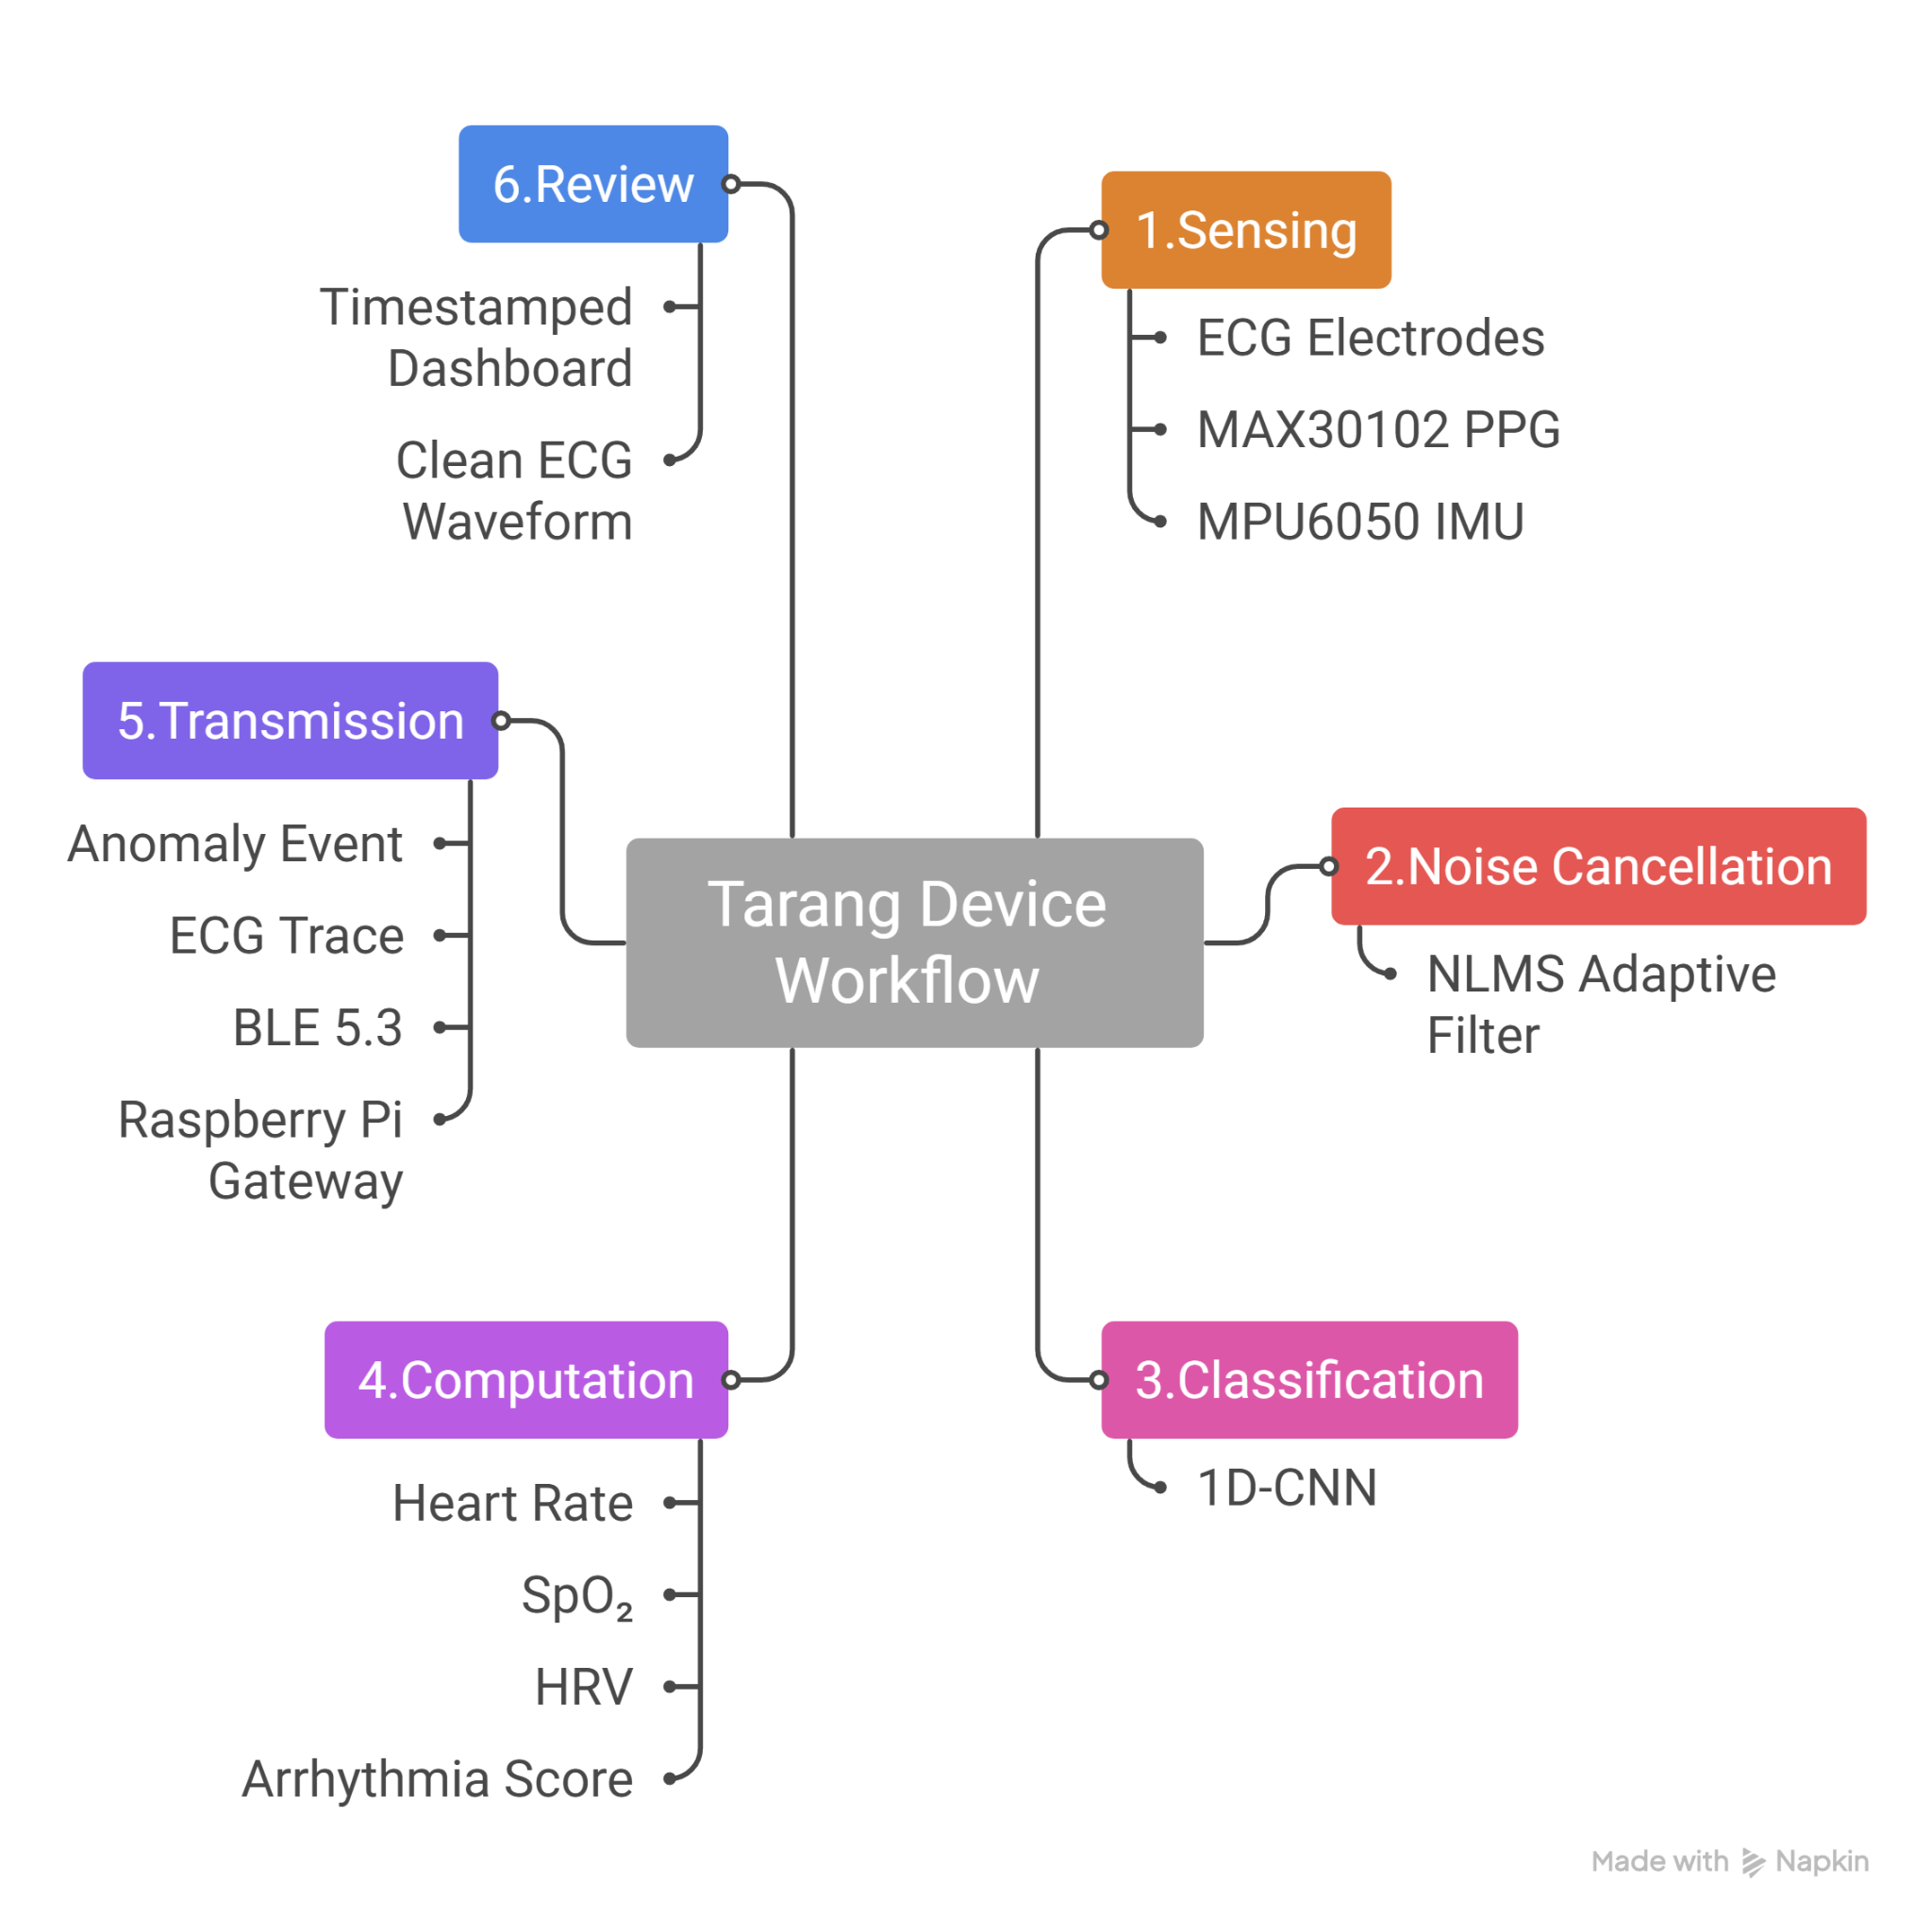
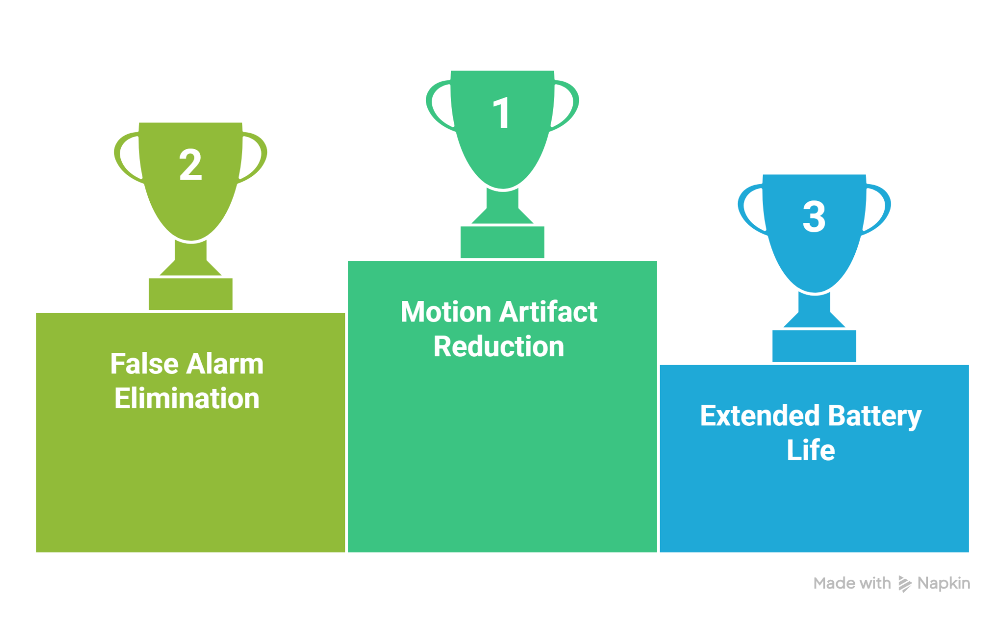
Objective
PROBLEM STATEMENT
"Current wearables fail exactly when patients need them most."
▸ ECG & PPG signals degrade up to 60% during motion - accurate diagnosis becomes impossible.
▸ ~80% of remote cardiac alerts are false positives
▸ Smartwatches offer 1–5 day battery life & No clinical-grade reliability
TARANG SOLUTION
"AI at the edge. Not after the cloud."
✔ Clean ECG even during motion - IMU-assisted
✔ Zero false-alarm noise - on-device 1D-CNN
✔ 30+ day battery life - PRS + LDMA zero-CPU autonomous sensing
USER FLOW
‹#›

Slide 5
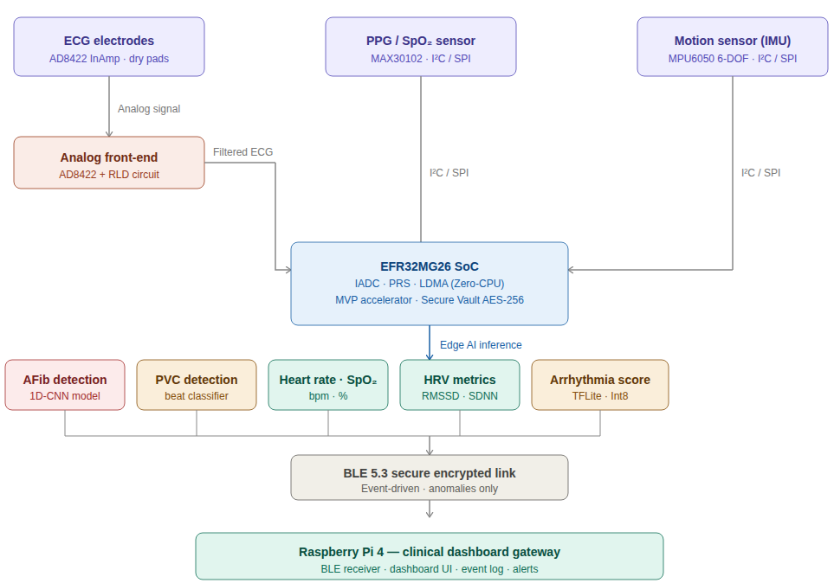
System Diagram
Key Specs
EFR32MG26 SoC
Multi-Sensor Fusion
Hardware MVP AI
Edge NLMS Filtering
1D-CNN Arrhythmia Detection
Secure Vault High
BLE 5.3 Event Telemetry
30+ Day Battery (EM2)
PRS/LDMA Zero-CPU
★ WIRELESS: BLE 5.3 | Encrypted,
event-driven, low-power.
★ EDGE AI: MVP hardware accelerator |
no cloud real-time
★ ZERO-CPU: PRS + LDMA
autonomous pipeline | >99% EM2 sleep
‹#›

Slide 6
Resource Allocation
HUMAN RESOURCES: Assigned roles based on experience and expertise
Kedar Nayak - Firmware / System Architect
PRS + LDMA zero-CPU pipeline, EM2 power optimization, power efficiency architecture, interrupt-driven firmware design
MohammadMehdi Namdar - AI / ML · Signal Processing
NLMS filter design, 1D-CNN model training & Int8 quantization, TFLite Micro deployment
Kartik Gautam - Hardware Integration · BLE · Sensor Fusion
AD8422 AFE + RLD circuit, dry electrode interface, PCB integration, MAX30102 PPG + MPU6050 IMU wiring, BLE 5.3 stack integration
Pal Patel - Hardware Design · Dashboard · Optimization
Clinical UI dashboard design, anomaly event logging, telemetry visualization, system-level performance optimization
EQUIPMENT AND TOOLS
EFR32xG26 Dev Kit
BGM220 Explorer Kit
Raspberry Pi 4
Assigned: primary MCU + MVP platform
Assigned: BLE development & testing
Assigned: gateway + dashboard
MAX30102 PPG Sensor
MPU6050 IMU
AD8422 InAmp + RLD
Procured: optical SpO₂ + PPG sensing
Procured: 6-DOF motion artifact reference
Procured: ECG analog front-end circuit
‹#›

Slide 7
Project Milestones
GOALS AND TIMELINE
Goal: Deliver a working prototype demonstrating real-time ECG motion cancellation and edge AI arrhythmia detection on EFR32MG26 hardware, live at the final presentation.
Phase 1
Architecture & Sensor Selection
Completed
Phase 2
Firmware + PRS/LDMA Zero-CPU Pipeline
Completed
Phase 3
AI Model Training & Int8 Quantization
Completed
Phase 4
Hardware MVP + NLMS Filter Integration
In Progress
Phase 5
Clinical Dashboard + BLE 5.3 Telemetry
Planned
Phase 6
Full Prototype + Demo Validation
Upcoming
Overall Progress: ~55%
‹#›

Slide 8
Work process
HOW TEAM OCELLEON WORKS: AI/ML at the Core
Team Logistics & Sync
Daily Synergy: In-person during university hours for prototyping.
Deep Dives: Weekly 90-minute Sunday virtual stand-ups for technical reviews.
Centralized Docs: Notion serves as the source for decisions and hardware datasheets.
Development Workflow
Version Control: GitHub feature-branch workflow with milestones in GitHub Projects.
Quality Control: Automated CI pipelines for firmware builds on every Pull Request.
Resource Hub: Shared Google Drive for large datasets and technical reports.
AI/ML Core: Tarang
Edge Intelligence: Quantized 1D-CNN (TFLite Micro) running on the EFR32MG26 hardware accelerator.
Artifact Suppression: IMU-assisted NLMS adaptive filtering for motion-proof ECG signals.
Optimized Performance: Validation : MIT-BIH/PhysioNet Datasets
Size: Ultra-lean <50KB memory footprint
Power Efficiency: Offloaded to MVP hardware for near-zero CPU load, maximizing battery life.
Data Integrity: 100% on-device processing ensures zero privacy risk and offline reliability.
‹#›

Slide 9
Risk Management
FORECASTED RISKS AND MITIGATION ACTIONS
Risk
Impact
Mitigation Action
Signal noise in electrode placement
HIGH
Active Right Leg Drive circuit with gel electrode fallback. Common-mode rejection via AD8422 InAmp.
CNN model too large for MCU flash
MEDIUM
Int8 quantization + TFLite Micro keeps model <50KB. Pruning available if needed.
BLE interference in clinical settings
MEDIUM
BLE 5.3 frequency hopping + AES-256 Secure Vault encryption ensures link reliability.
Power budget exceeded during inference
HIGH
MVP runs only on interrupt. PRS+LDMA keeps CPU in EM2 >99% of the time.
Hardware damage or component delay
LOW
All components duplicated in BOM. BGM220 Explorer Kit as secondary fallback platform.
‹#›

Slide 10
Additional information
SYSTEM OUTPUTS
❤️ Heart Rate
🩺 Arrhythmia Detection
🔵 SpO₂ Level
Real-time BPM measurement from ECG + PPG fusion. Updated every heartbeat.
AFib and PVC classification via 1D-CNN. Probability score per event.
Blood oxygen saturation (%) from MAX30102 optical sensor.
📊 HRV Metrics
📡 BLE Event Log
📈 ECG Trace (Clean)
Heart Rate Variability analysis for recovery and stress monitoring.
Timestamped anomaly packets transmitted via BLE 5.3 to gateway.
Artifact-free ECG waveform after NLMS filtering, visible on dashboard.
FEASIBILITY
CUSTOMIZABILITY & FUTURE EXPANSION
Hardware: Full utilization of EFR32xG26, BGM220, and RPi 4.
Firmware: Leveraging Silicon Labs native SDKs and TFLite Micro libraries.
Risk Profile: No custom silicon; eliminates supply chain or fabrication delays.
Viability: Proven hardware path for a demo-ready prototype by deadline.
Clinical Versatility: Extends to respiratory monitoring (SpO2/breath-rate)
Industrial Safety: Integration into Smart PPE to track worker heat stress and cardiac strain in high-risk environments.
Privacy-Preserving AI: Implementing models without exposing raw patient biometric data.
‹#›

Slide 11

‹#›

